Slide 1
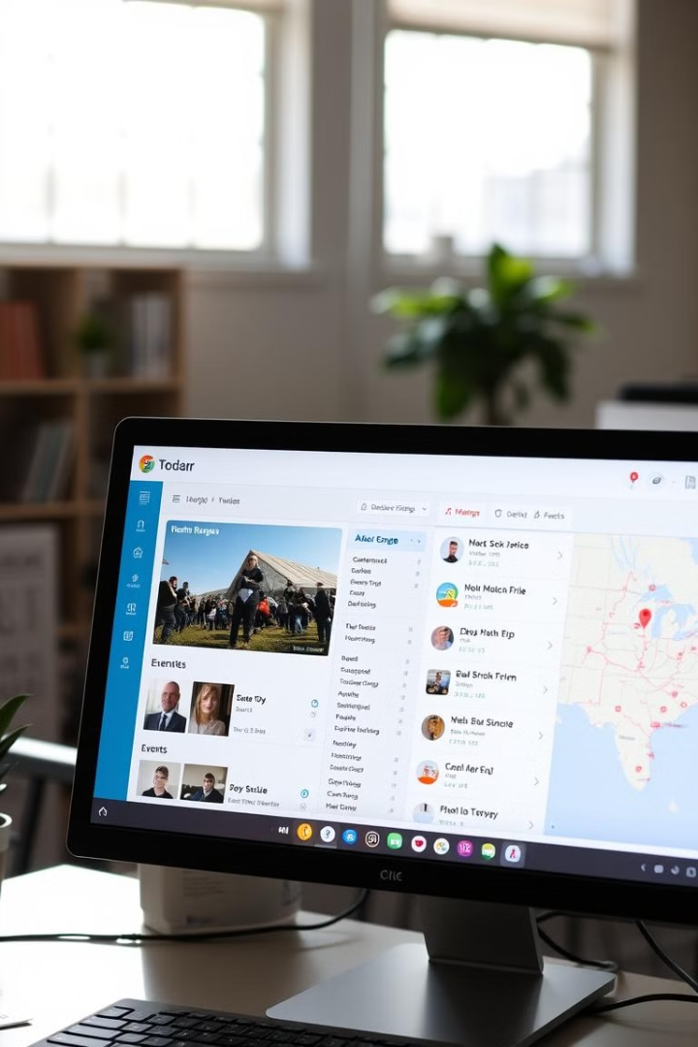
Event Management System Overview
This presentation outlines the features and functionality of a comprehensive event management system designed to streamline event organization and management. The system offers a range of features, including event creation, ticketing, venue selection, and user access control.

Slide 2

Meet Our Talented Team
Ammar Gohar
Sara Amin
Hamdy Radwan
Aly Mohamed

Slide 3
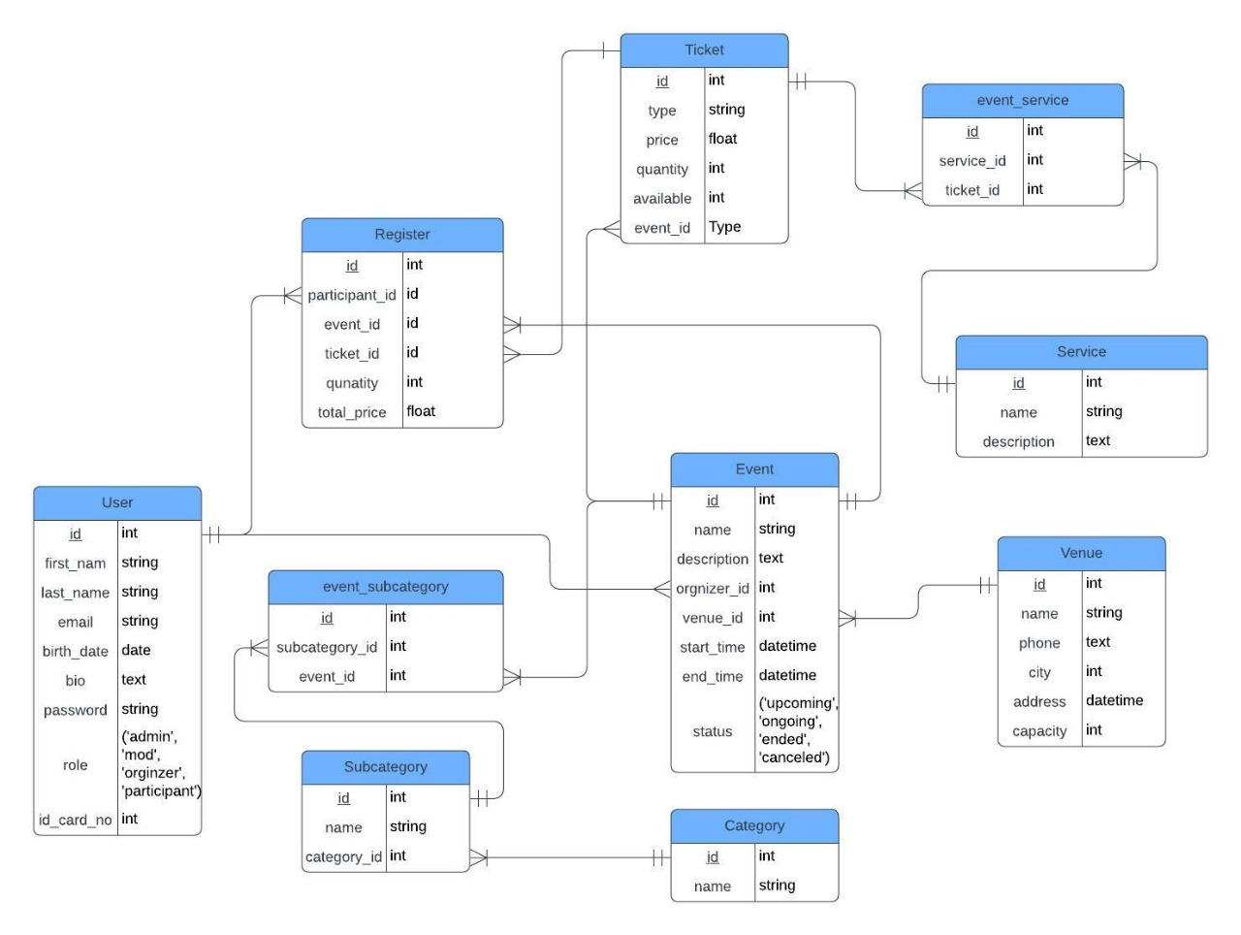
ER diagram of the project

Slide 4
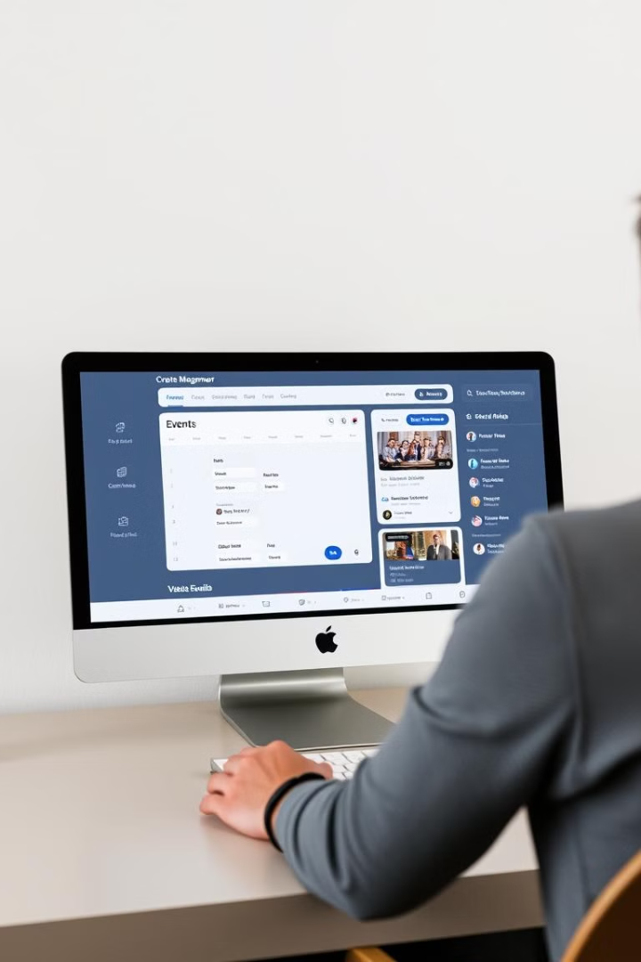
Introduction to the Project
Purpose
Target Audience
The event management system is designed to simplify the process of organizing and managing events.
The system caters to event organizers of all sizes, from individuals hosting small gatherings to professionals managing large-scale conferences.
Key Features
The system offers a range of features, including event creation, ticketing, venue selection, and user access management.

Slide 5
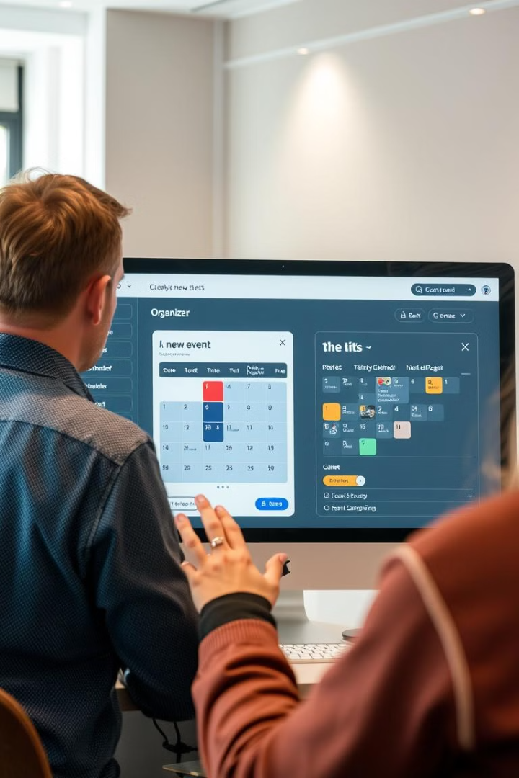
Key Features of the System
Event Creation
Ticketing
Organizers can easily create and manage events, setting dates, times, locations, and event details.
The system integrates a flexible ticketing system, allowing organizers to set ticket types, pricing, and availability.
Venue Selection
User Access Control
Organizers can browse and select venues based on capacity, location, and other criteria.
Role-based access control ensures secure management of events and data, with varying levels of permissions for different user roles.

Slide 6
User Roles and Permissions
Administrator
Organizer
Attendee
Administrators have full control over the system, including managing users, events, venues, and ticketing.
Organizers can create and manage events, set ticket prices, and select venues.
Attendees can view event details, purchase tickets, and manage their registrations.

Slide 7
Event Creation and Management
Event Creation
1
Organizers enter basic event details, including name, description, date, and time.
2
Venue Selection
Organizers search for and select a venue based on location, capacity, and other criteria.
Ticket Configuration
3
Organizers define ticket types, pricing, and availability for the event.
4
Event Promotion
Organizers can promote their events through the system, sharing event details and ticketing information.
Attendee Management
5
Organizers can manage attendee registrations, track ticket sales, and communicate with attendees.

Slide 8

Ticketing System and Venue Selection
1
2
Ticket Types
Pricing and Availability
Organizers can create various ticket types, such as general admission, VIP, or early bird.
Ticket prices can be set individually for each type, and organizers can control ticket availability.
3
4
Venue Selection
Integration
Organizers can browse a database of venues, filtering by location, capacity, and other criteria.
The ticketing system seamlessly integrates with venue details to ensure accurate seating arrangements and capacity management.

Slide 9
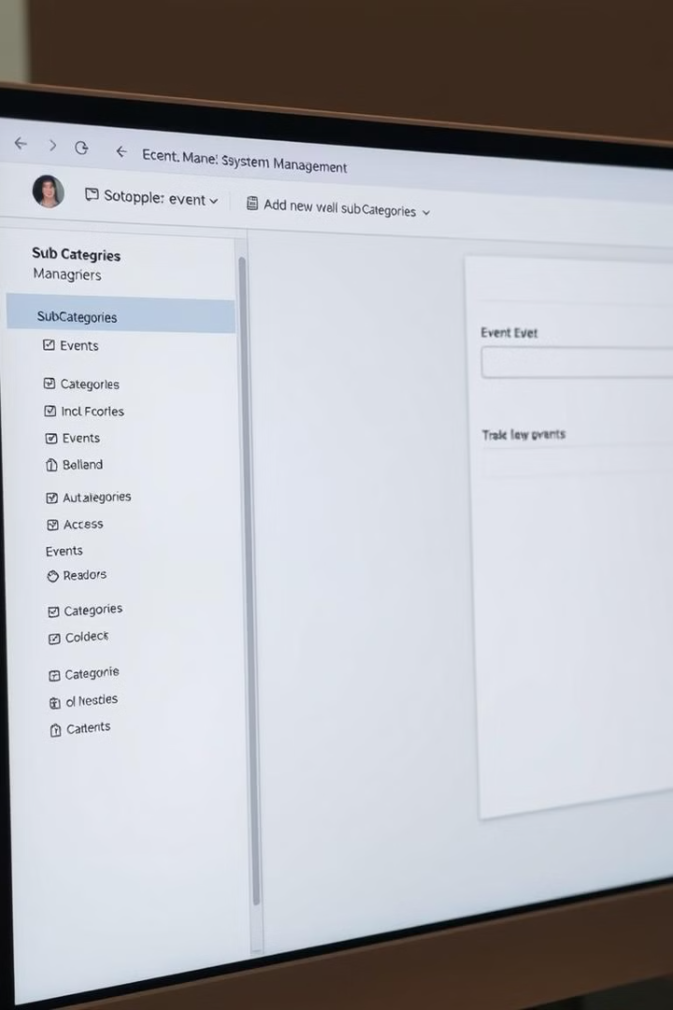



Categories costumiz
Define Categories
Organizers can create main categories to group events.
Create Subcategories
Within each category, organizers can create subcategories for specific event types.
Customize Subcategories
Organizers can set unique descriptions, logos, and color schemes for each subcategory.

Slide 10
MVC Design Pattern in Laravel 10
Model
View
Controller
The Model represents the data and business logic of the application. It interacts with the database to store, retrieve, and manipulate event data.
The View is responsible for presenting the user interface. It receives data from the Controller and renders it into dynamic web pages.
The Controller acts as the intermediary between the Model and View. It handles user requests, retrieves data from the Model, and prepares it for the View.

Slide 11
Local Hosting with Laragon
Simplified Setup
Integrated Environment
Easy Management
Laragon simplifies local development by providing a single package with essential web server components.
Laragon includes Apache, MySQL, and PHP, eliminating the need for separate installations.
Laragon offers a user-friendly interface for managing databases, virtual hosts, and other settings.

Slide 12
Database Management with PHPMyAdmin
Web-Based Interface
Table Management
Data Manipulation
Query Editor
Users can create, modify, and delete tables, define columns and data types, and manage relationships between tables.
PHPMyAdmin allows for inserting, updating, and deleting data within tables, with tools for browsing and editing records.
A SQL query editor enables users to execute complex SQL queries, providing syntax highlighting and error detection.
PHPMyAdmin provides a user-friendly web interface for managing MySQL databases, eliminating the need for command-line tools.

Slide 13
Thanks

